Slide 1
Analytical Methods for Business
Dr. Ronald K. Satterfield
Muma College of Business
University of South Florida

Slide 2
Multiple Regression Explaining More
Dr. Ronald K. Satterfield
Muma College of Business
University of South Florida

Slide 3
Plan for This Presentation
Simple Regression Practice
Multiple Regression Practice
Binary Variables
Assignment

Slide 4

Hotel Restaurant

Slide 5

Warehouse Cost

Slide 6
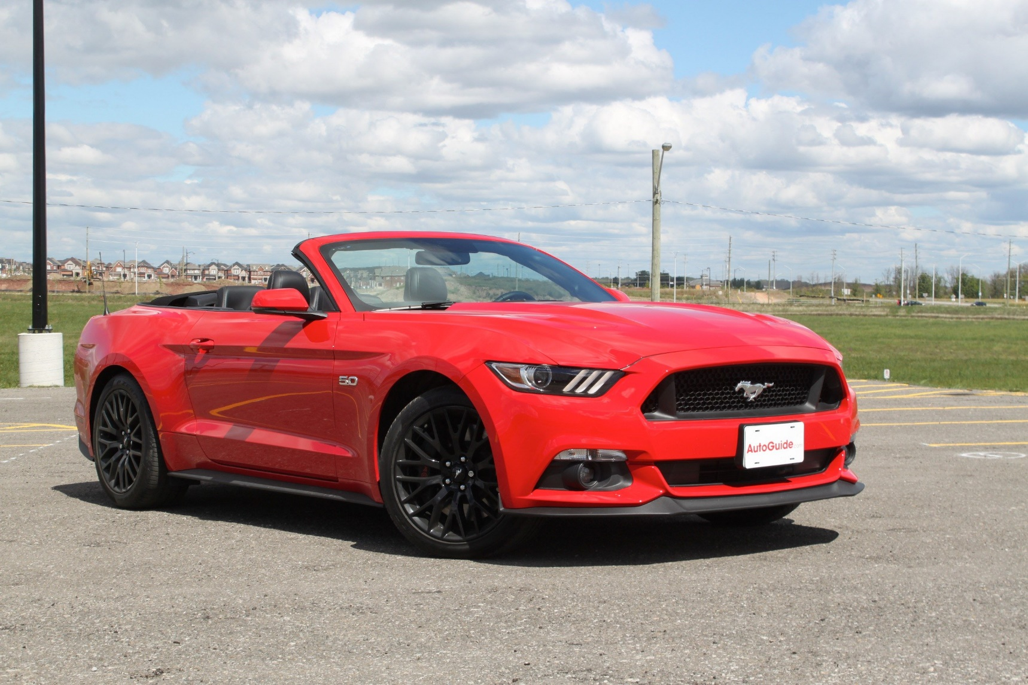
Miles per Gallon

Slide 7

Child Abuse

Slide 8

House Appraisals

Slide 9
Assignment

Slide 10
What Have We Covered?
Practice with Simple Regression
Extension to Multiple Regression
Practice with Multiple Regression
Special Modeling Forms

